Slide 1

UFHR Forum
February 4, 2026

Slide 2
Agenda
Empowering UF: Project Update & Security Role Mapping
Benefits: IRS Documents (1095-C) & Double Deductions
Training: Accessibility Guidelines & UFHR Toolkits
Understanding UF Policy Development
Reference Checks
Compensation Reminders
Important Dates

Slide 3
Empowering UF
Amber Wuertz

Slide 4
Project Timeline: Where Are We Now?
We are here
Go Live
 | 2024 |  |  |  |  |  | 2025 |  |  |  |  |  |  |  |  |  |  |  | 2026 |  |  |  |  |  |  |  |  |  |  |  | 2027
Timeline | J | A | S | O | N | D | J | F | M | A | M | J | J | A | S | O | N | D | J | F | M | A | M | J | J | A | S | O | N | D | J | F | M | A | M | J | J | A | S | O | N | D
Workday Implementation: FIN/HCM | Post-Selection Readiness |  |  |  |  |  | Plan |  | Architect & Configure |  |  |  |  |  |  |  |  |  |  |  | Test |  |  |  |  |  |  |  |  |  |  |  |  |  | Deploy |  | Stabilization |  |  | Optimization
Implementation Launch
02/07/2025
Configuration Workbooks/
Complete Design
06/20/2025
Complete Configuration
and Build
02/27/2026
E2E Test #1 Results
10/23/2026
Foundational Tenant Build
A&C 1
Payroll Compare Test Results/
Complete Payroll Testing
03/25/2027
Discovery
Sessions
A&C 2
Design
Sessions
A&C 3
Gold Tenant/
Production Use (Go-Live)
07/01/2027
Complete Stabilization Period
09/30/2027
Complete Optimization Period
12/31/2027

Slide 5
Workday Security
What is happening now:
In November, we brought together HR Liaisons, Financial Accountability Officers, Research Liaisons, and IT leaders for an orientation on how Workday security functions and the roles used within Workday.
Each college and core office unit was asked to establish a mapping team to begin mapping individuals to Workday roles. Although this effort may seem early, the mappings will support system testing and help confirm that role-based access operates as expected at go-live.
To support those completing the initial security role mapping, the project is hosting weekly office hours to provide guidance, answer questions, and resolve issues in real time. The first pass of security roles in Workday will be completed in February.

Slide 6
Security Role Mapping | Timeline
2025 |  |  |  |  |  |  |  |  |  |  |  | 2026 |  |  |  |  |  |  |  |  |  |  |  | 2027
J | F | M | A | M | J | J | A | S | O | N | D | J | F | M | A | M | J | J | A | S | O | N | D | J | F | M | A | M | J | J | A | S | O | N | D
Plan |  | Architect & Configure |  |  |  |  |  |  |  |  |  |  |  | Test |  |  |  |  |  |  |  |  |  |  |  |  |  | Deploy |  | Stabilization |  |  | Optimization
Nov ’25 – Feb ‘26
Mar ’26 – Jan ‘27
Feb ’27 –
May ‘27
May ’27 – Jul ‘27
Security Role Mapping Process
Initial Security Role Mapping Process
Initial Security Roles Assignments used in E-UF Testing Phase
Update Security Role Mappings Prior to Go-Live
Security Roles loaded to UF Production Tenant for Go-Live
We are here!

Slide 7
Stay Connected
Website: https://empowering.ufl.edu/overview/
Timeline
Updates & FAQs
Early Education Resources
Contact Form to connect with the team

Slide 8
Benefits
Shannon Edwards

Slide 9

IRS Reporting Form – 1095-C
Employer Provided Insurance Offer and Coverage
Reports employees’ health insurance information for prior calendar year
State 1095s - available in PeopleFirst, if you opted for electronic delivery
GatorCare 1095s - beginning with calendar year 2025, these forms will be provided by request only by requesting it via benefits@ufl.edu.
Employees may file income tax returns prior to receiving 1095-C if they know they had coverage for the entire year

Slide 10
Double Deductions
9/10 Month Employees
Active 9/10-month employees have double premium deductions during the spring to cover summer when no payroll is issued
Double deductions
  BEGIN: 2/6/2026 paycheck
  ENDS: 5/1/2026 paycheck
Departments with new 9/10-month employees whose hires are executed between February 1st and the start of the Fall term should advise their new hires to contact UFHRUniversity Benefits for assistance regarding benefit premiums
If no action is taken, premiums will be underfunded, and coverages may be suspended
If someone recently moved from 12M to 9M please have them check their paychecks for doubles

Slide 11
Training & Organizational Development
Gwynn Cadwallader

Slide 12


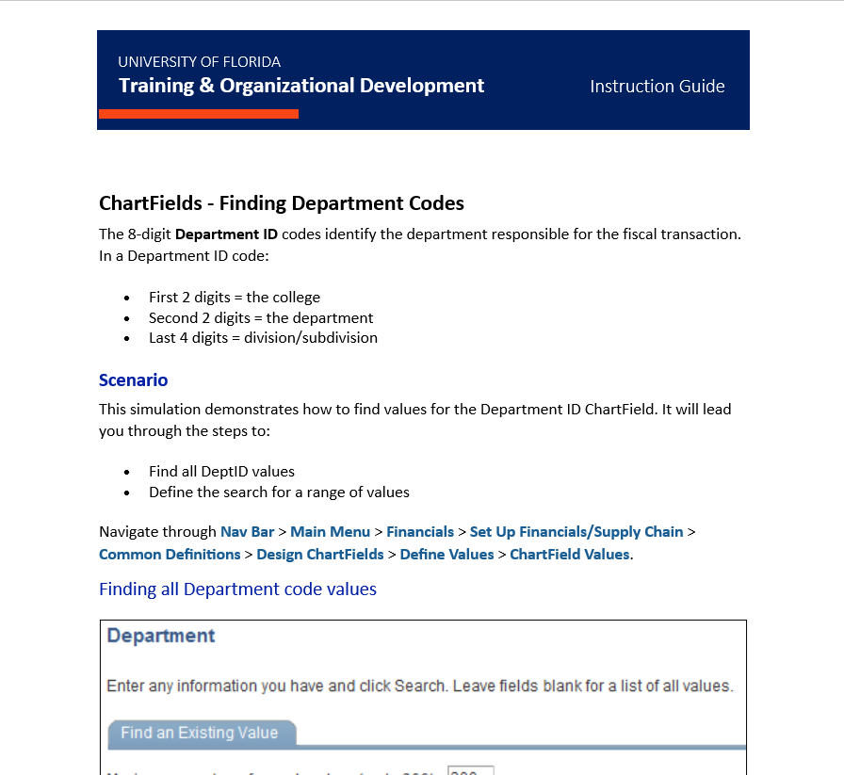

New ADA format for the UFHR Toolkit Instruction Guides
Word Documents, Open as read only
Update any bookmarks.
Share this information with others in your unit.
Best Practice: Always get the latest version from the website.
https://hr.ufl.edu/professional-development/toolkits/
Notes:
UF is preparing to respond to new ADA Title II regulations released by the U.S. Department of Justice on April 24, 2024. The new regulations mandate that web content and mobile applications offered by public entities will conform to WCAG 2.1 level AA standards, with few exceptions, by April 24, 2026.
Action – update your bookmarks
Share with your teams
While these are Word docs – T&OD will continue to partner with the Core Office to keep the guides as up-to-date as possible.

Slide 13
Understanding UF Policy Development
David Altman

Slide 14
Session Objectives
Understand how UF Policies are developed
Learn how departments can assist in policy initiatives
Clarify policy vs procedure
Introduce the University Policy Group

Slide 15
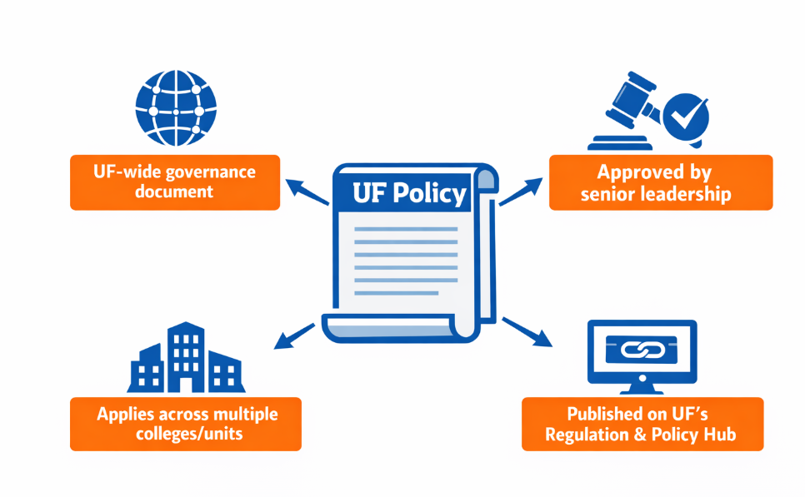
What Is a UF Policy?

Slide 16
Unit-Level Policies
Apply within a specific unit
Must align with / not override UF-wide Policies
Often focus on local operations and expectations
Not subject to stringent UPG requirements

Slide 17
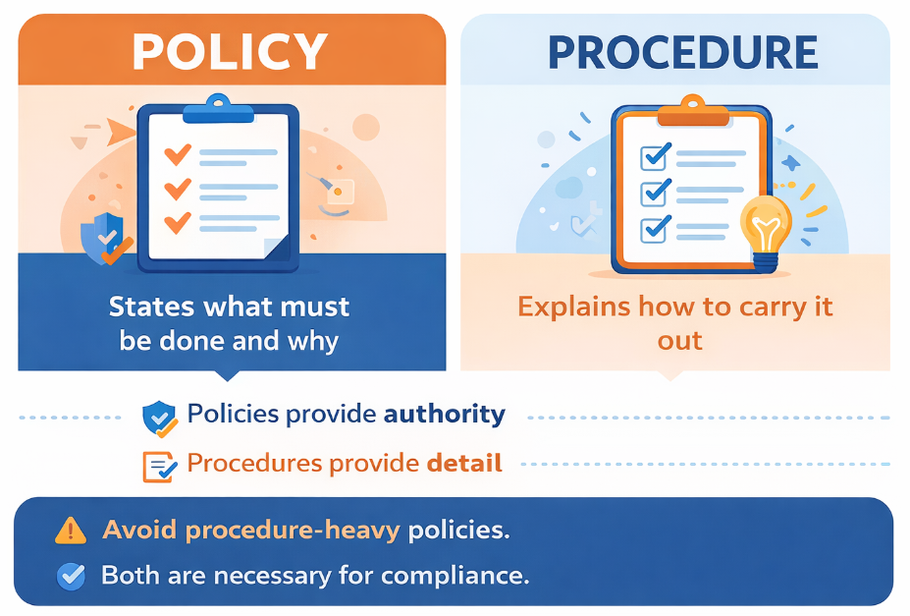

Slide 18
The University Policy Group
Oversees UF Policy framework
Maintains UF’s Regulation and Policy Hub
Develops templates and guidance
Offers drafting support
Coordinates legal and compliance reviews
Supports executive Policy owners

Slide 19
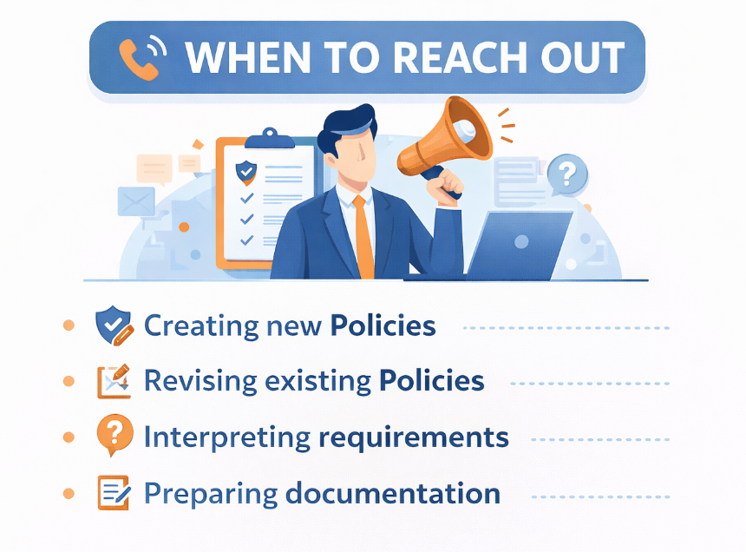

Slide 20
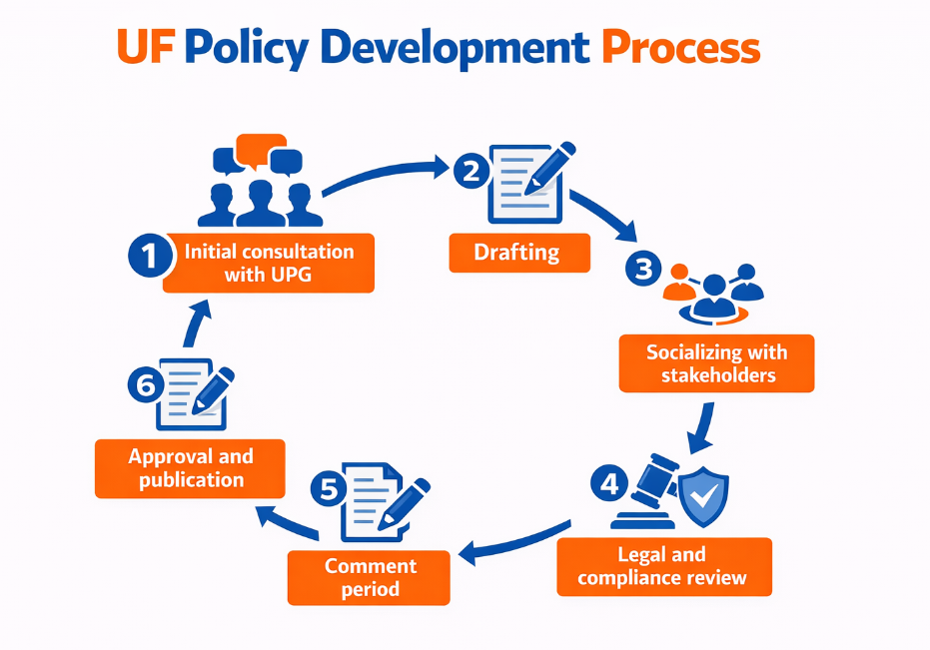

Slide 21
Roles and Responsibilities
Responsible Executive
• Provides strategic oversight
• Approves major revisions
• Ensures institutional alignment/ champions process
Responsible Office
• Drafts and maintains policy
• Leads training and education
• Answers operational questions
• Monitors implementation
Policy Liaison
UPG

Slide 22
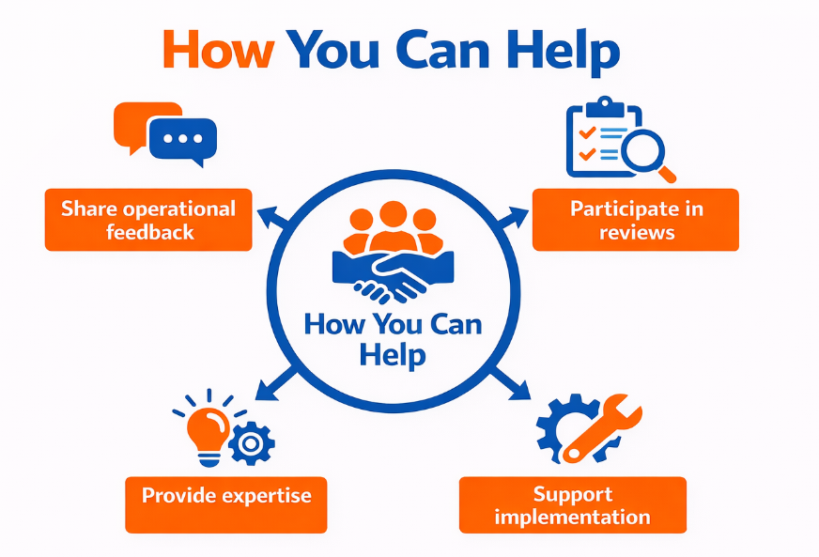

Slide 23
Drafting Tips
Access the Policy Drafting Guide at https://policy.ufl.edu
Define and use key terms
Follow UF Policy Template
Avoid complexity
Consider enforcement and accountability

Slide 24
Key Resources
UF’s Regulations and Policy Hub: https://policy.ufl.edu
The Policy on Policies
Policy Template
Policy Drafting Guide
Policy Development Forms
UPG Website and Guidance

Slide 25
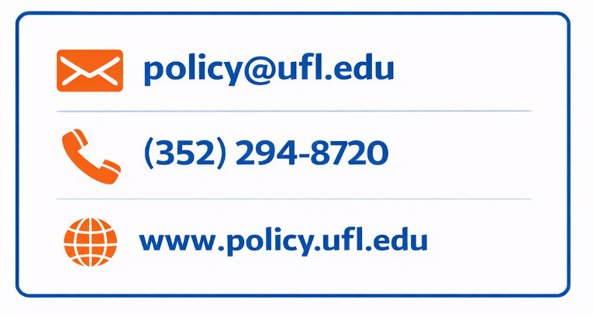
University Policy Group Contact Information

Slide 26
Reference Checks
Andy Fischer

Slide 27
Use Spark Hire to Request Reference Checks
This enhancement simplifies the process, so you can seamlessly invite candidates to engage in reference checking from one place.
When you request references through Spark Hire, both the candidate and their chosen references go through a simple, step-by-step flow.
Using Spark Hire functionality helps you collect structured, confidential feedback from a candidate’s former colleagues, managers, or peers.
By automating the process with Spark Hire, you can save time, reduce bias, and uncover key details about a candidate’s past performance all before making your final hiring decision.

Slide 28
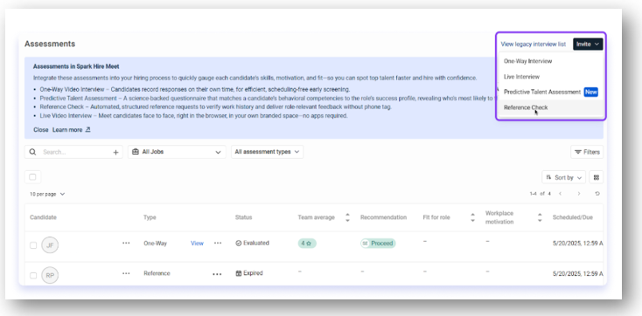


Setting up Your Reference Survey
To request a reference check for a candidate that has completed a Spark Hire Interview:
From the View job page, click ’Invite’ > ‘Reference Check’ at the top of the page.

Slide 29
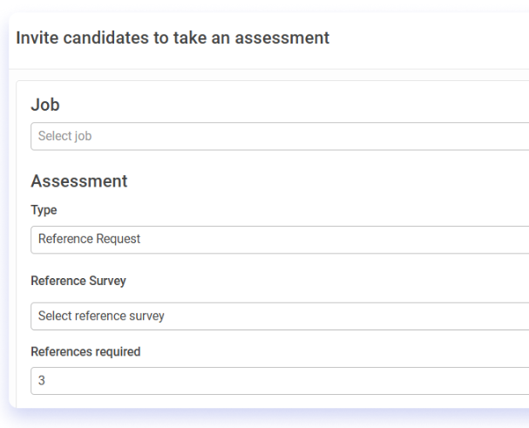
Setting up Your Reference Survey
Select the job the reference check is for.
Choose a Reference survey and the number of references you'd like to request.
If you do not wish to use a customized survey, you may always use Spark Hire’s default Reference survey.

Slide 30
Inviting the Candidates
Select the job the reference check is for.
Choose a Reference survey and the number of references you'd like to request.
If you do not wish to use a customized survey, you may always use Spark Hire’s default Reference survey.

Slide 31
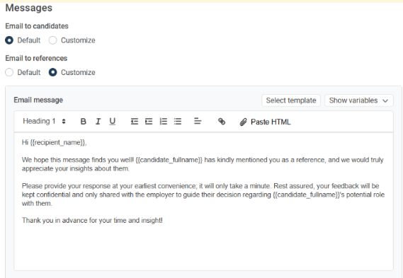
Customize Your Message
If you want to edit the email invitation and advise the candidate of the level of reference needed (Supervisory Reference, Peer-to-Peer Reference, Subordinate Reference, Professional Reference, etc.), you may use a customized option.

Slide 32
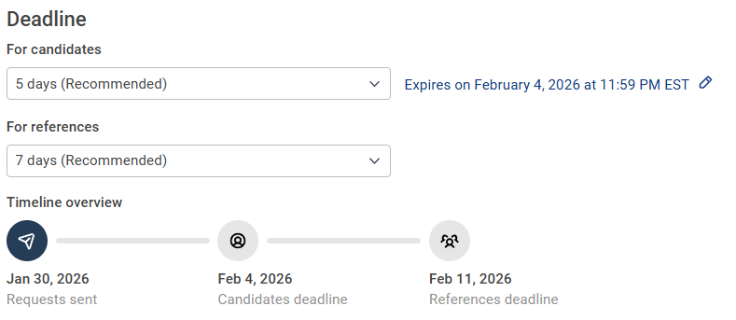


Set a Completion Deadline
This functionality will allow you to set a ‘completion deadline’ for the candidate and references prior to sending the invite.

Slide 33

EASY WAY TO
REQUEST CANDIDATE REFERENCES
For more information contact: talent@hr.ufl.edu or
visit the Hiring at UF Toolkit

Slide 34
Compensation Reminders
Brent Goodman

Slide 35
Florida Minimum Wage Reminder
Florida voters approved an amendment in November 2020 that increases the minimum wage each year until it reaches $15 per hour in 2026
Effective September 30, 2026, the minimum wage will increase to $15 per hour
This increase predominately impacts non-exempt OPS, student assistants, and federal work-study positions
As of February 2, we identified approximately 3,220 appointments below the new minimum wage
The cost including fringe of increasing the population to the new minimum wage is approximate $2.36M
Questions? Classification & Compensation - compensation@ufl.edu – 352-273-2842

Slide 36
UF Staff Salary Structure – January 1
  UFHR’s Classification & Compensation team completed the annual review of the UF staff market pricing
  Each pay grade includes a lower market reference point, a midpoint, and an upper market reference point
    Allows flexibility to adjust pay based on
      External market benchmarks for individual jobs
      Individual skill level, experience, and performance
  New grade assignments have been updated in myUFL and on the TEAMS Titles website
  These changes may influence new hires, reclassifications, postings, and other HR transactions
  Future updates to the salary structure will be effective July 1

Slide 37
Important Dates
March 4 • HR Forum
March 14-21 • UF Spring Break

