Slide 1

UFHR Forum
April 1, 2026

Slide 2
Agenda
Essential Employees
Staff Salary Structure Annual Review
PageUp Updates
UF Engaged
Short Work Breaks & Summer Appointments
Graduate Assistant Benefits & Comp Leave Cashouts
Youth Compliance
EEP Summer Applications
Important Dates

Slide 3
Essential Employees
Brook Mercier

Slide 4
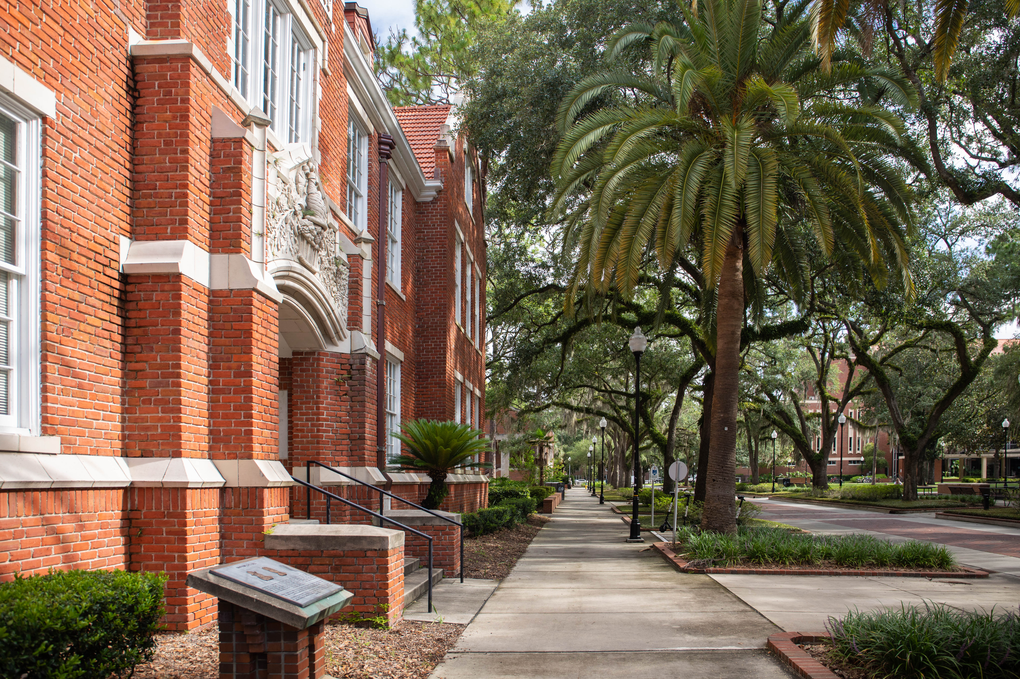
ESSENTIAL EMPLOYEES
Essential employees provide vital support to the University of Florida in the event of an emergency or disaster that results in the official suspension of classes and/or closing of offices. Essential employees also support planned campus closures for events such as commencement.

Slide 5
ESSENTIAL EMPLOYEES
Essential employees play an important role in maintaining the safety and well-being of students, faculty, and staff who may be remaining on site throughout emergency events.
During a campus closing, only employees designated as On-Campus Essential may be present on campus.
Essential employees may have activated before, during or after an emergency, when offices are closed.

Slide 6
ESSENTIAL EMPLOYEES
On-Campus Essential – Working on campus
Continuation of critical and/or essential services that must be completed on-site
Maintaining integrity of infrastructure, property or systems on-site
Necessary on-campus work to maintain the safety and wellbeing of students, faculty and staff
Remote Essential – Working from a remote location, may need periodic access to campus when closed
Work is required to maintain operations and business continuity of the University and can be completed remotely
Supervisor approved access to campus may be needed periodically to complete required work
Remote Non-essential – Working from a remote location, does not need access to campus when closed
Work is important to the University and can be completed remotely, but is not essential to maintain operations and business continuity

Slide 7
ESSENTIAL EMPLOYEES
Colleges and Departments are responsible for designating and notifying essential employees.
Essential employees may be required to report to work, be “on call” to report to work, and/or work remotely if required in order to maintain the critical functions of the University during a closure.
In the event of an emergency closing, supervisors notify essential employees if and when they are required to report to work.
Essential employees have a responsibility to monitor official University of Florida communications related to an emergency, including UFAlert and UFL.edu, as well as maintain up to date contact information in myUFL.

Slide 8
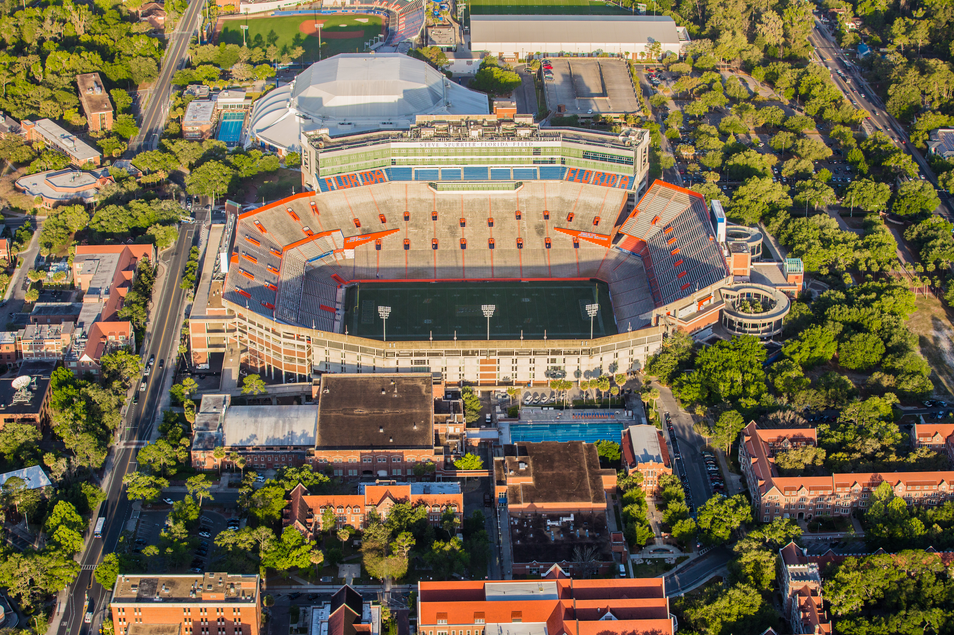
ESSENTIAL EMPLOYEES
Essential employees should receive and acknowledge written designation from their supervisor
A standardized designation letter template is available to departments
Job descriptions for essential employees should contain this designation

Slide 9
ESSENTIAL EMPLOYEES
TEAMS non-exempt and Law Enforcement non-exempt employees who are required to work during an emergency closing will earn one hour of special compensatory leave for each hour worked during the emergency closing, in addition to their normal pay.
If the special compensatory leave is not used by the end of the fiscal year, the employee will be paid for the leave.
TEAMS exempt employees who are required to work during an emergency closing are eligible for compensatory leave at the discretion of the supervisor — although this compensatory leave is handled informally at the department level and not accrued in myUFL.
Faculty, graduate assistants, and student assistants are not eligible for compensatory leave under this policy. Special consideration should be given before designating student assistants as essential.
Areas with vendors should contact the vendor about staffing and service expectations and incorporate contract language for essential services.

Slide 10
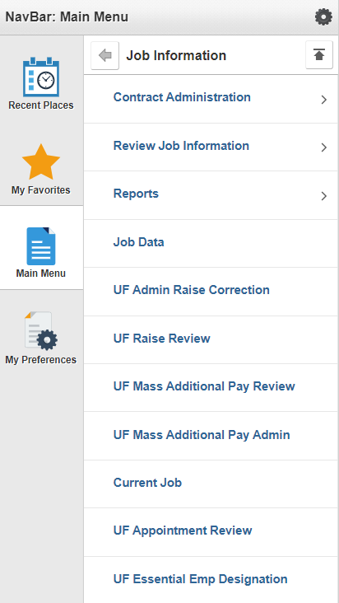
ESSENTIAL EMPLOYEES
HR Liaisons record the designation in the UF Essential Employee Designation file in myUFL.
Navigation-
myUFL Main menu > Human Resources > Workforce Administration > Job Information > UF Essential Emp Designation

Slide 11
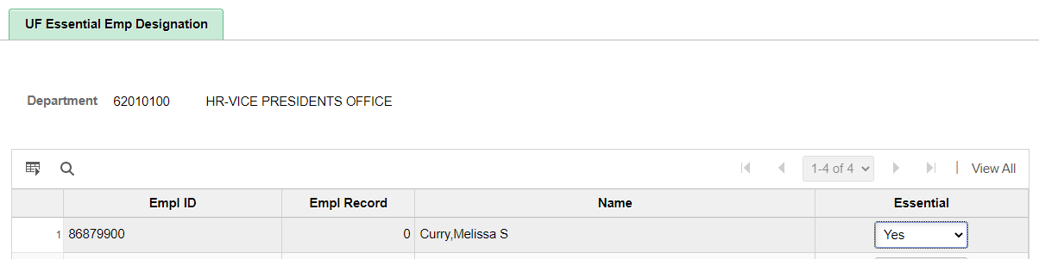
ESSENTIAL EMPLOYEES
Navigation
myUFL Main menu > Human Resources > Workforce Administration > Job Information > UF Essential Emp Designation

Slide 12
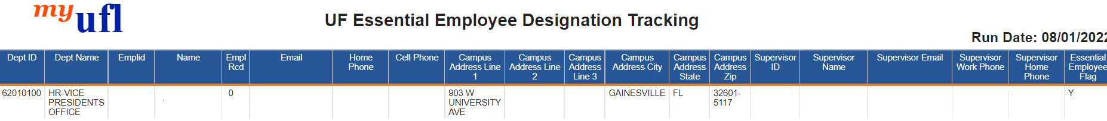
ESSENTIAL EMPLOYEES
myUFL Enterprise reporting
Team Content > Human Resources Information > Workforce Information > UF Essential Employee Designation Tracking

Slide 13


ESSENTIAL EMPLOYEES
Available Resources
https://hub.policy.ufl.edu/s/article/Essential-Employees

Slide 14
Classification & Compensation
Kenya Williams

Slide 15
UF Staff Salary Structure – January 1
UFHR’s Classification & Compensation team completed the annual review of the UF staff market pricing
Each pay grade includes a lower market reference point, a midpoint, and an upper market reference point
Allows flexibility to adjust pay based on
External market benchmarks for individual jobs
Individual skill level, experience, and performance
New grade assignments have been updated in myUFL and on the TEAMS Titles website
Salary Structure and Pay Grades
TEAMS Titles
Future updates to the salary structure will be effective July 1

Slide 16
Updated Manager Forms
TEAMS & Faculty
Special Pay Increase Request
Effective date is the date UFHR/Provost or designee approves special pay action
Request of Approval of Additional University Employment (HR600)
Required authorization from UFHR Immigration Compliance Services for international employees

Slide 17
Operational Process Improvements
We have identified strategies to improve operational processes
Maintain compliance
Improve accuracy
Better reflect current state as we prepare for Workday implementation
As of April 1, mandatory review of position descriptions prior to posting
Effective May 1, vacant positions that have been vacant for a minimum of three (3) years will be inactivated

Slide 18
Talent Acquisition & Onboarding
Audrey Gainey

Slide 19
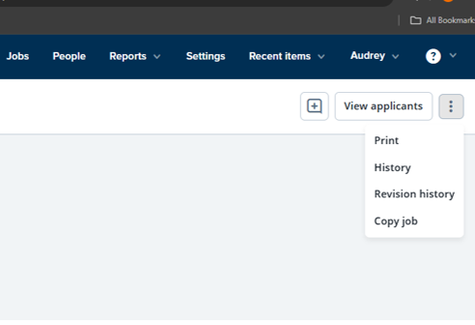
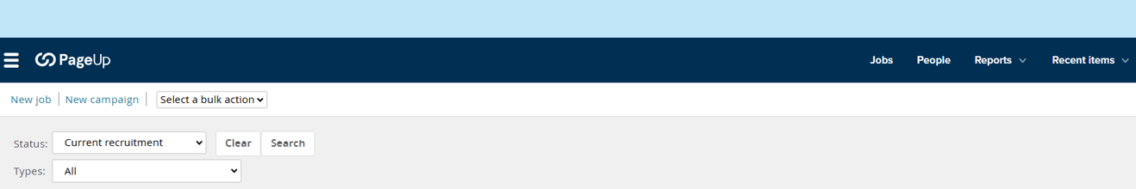

PageUp (Careers at UF) Updates
Effective COB today, April 1st, the “Copy Job” feature will no longer be available.
Users will need to select the “New Job” option from the tool bar to create a requisition.

Slide 20
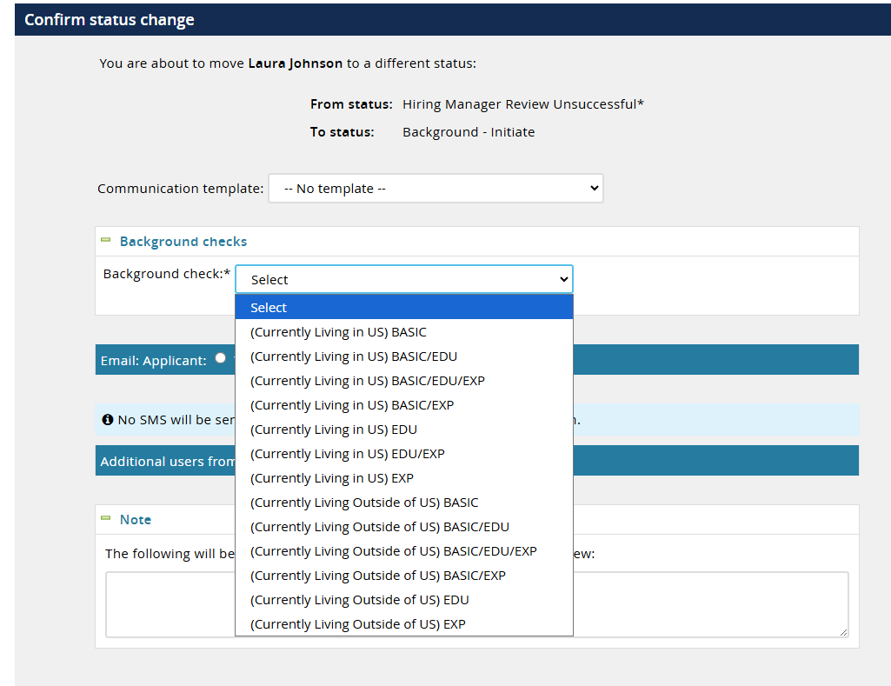
PageUp (Careers at UF) Background Screening Packages
Coming Soon!
Packages will be role-specific to facilitate accurate selection and promote consistency across colleges and units.

Slide 21
UF Engaged
Bob Parks

Slide 22
UF Engaged Deadline
UF Engaged evaluations for this semi-annual cycle need to be completed by April 30.
Remind your supervisors that these are not optional. Units are expected to have 100% completion rates.
Resources available on UF Engaged toolkit website: https://hr.ufl.edu/professional-development/toolkits/uf-engaged-toolkit/
If you have questions or need assistance, please email UFEngaged@hr.ufl.edu.

Slide 23
Employment Operations & Records
Jennifer Evans

Slide 24
Short Work Break
Upcoming Action Items
Short work break file load will take place on April 17, 2026
Action needed by departments
Verify all 9- and 10-month employees (faculty, graduate assistants, and TEAMS) who will not return after Spring 2026 are terminated in myUFL
If necessary, enter end-of-semester terminations PRIOR to April 16, 2026
9-month employees: 5/16/26
10-month employees: 6/2/26

Slide 25
Short Work Break Cont.
Navigation & Resources
To review employees on short work break after April 17th
Main Menu > Enterprise Analytics > Access Enterprise Analytics > Team Content > Human Resources Information > Workforce Information > Short Work Break – Return From Break Report
The return from short work break rows will load the week of July 6th
Instruction Guide
https://admin.hr.ufl.edu/short-work-break-2026-docx/

Slide 26
Faculty & GA Summer Appointment
Summer Job File
Summer appointments for 9-month faculty and graduate assistants may be processed via the summer job file
Summer appointments may also be entered as a Hire ePAF
File opens April 17, 2026
File closes May 8, 2026
Summer appointments will load in Job Data the afternoon of May 12, 2026

Slide 27
Faculty & GA Summer Appointment Cont.
Summer Job File
The file will be available via myUFL system
Main Menu > Human Resources > Workforce Administration > Job Information > UF Summer Job Review
Instruction Guide
https://admin.hr.ufl.edu/preparing-the-uf-summer-job-review-file-2026-docx/
Departments will be contacted by EOR if there are employees who do not load and may need additional action on your part
Doublecheck GA stipend amounts to ensure compliance with the GAU CBA minimum stipend amounts based on FTE

Slide 28
Summer Appointments – Keep in Mind!
Summer Job File
Updating Job Data
Example: Supervisor ID updates
Transferring records
Should not transfer while on short work break; if needed, department will need to contact our office to return them earlier than August (ex: converting 9-month to 12-month)
Terminating records
Must avoid impacting an employee’s benefits if they are returning in the fall

Slide 29
Graduate Assistant Reappointment Notices
Upcoming Deadlines
GAU CBA Article 4.5- Employees eligible for reappointment shall receive written notification of continuation or non-continuation of employment on the following schedule:
9-month appointments: by May 15th for the following academic year.
12-month appointments: ninety (90) days prior to expiration of existing appointment.
One semester appointments: forty-five (45) days prior to expiration of existing appointment.
Note: If the GA’s specific assignments are known prior to these deadlines, then providing them their regular appointment letter instead of this reappointment letter is recommended.
Reappointment Template: https://hr.ufl.edu/wp-content/uploads/2025/03/GA-Reappointment-Notice-Template_March-2025.docx

Slide 30
Benefits
Shannon Edwards

Slide 31
Graduate Assistant (GA) Short Work Break vs Termination
Do not submit a termination ePAF on the main appointment for GAs who:
Are returning in the fall
Have a summer appointment
Terminating the 9M appointment will cancel GatorGradCare at the end of the month employment ends
Trigger refunds for double coverage
Potentially leave GAs without summer coverage
GatorGradCare requirements:
Different from state benefits and requires an active employment record to maintain coverage (i.e. Short-Work Break)
Upcoming outreach:
GAs with end-of-May terminations will be contacted to confirm if corrections are needed
Questions or unique situations? Please email us at gabenefits@hr.ufl.edu for assistance

Slide 32
Fiscal Year Comp Leave Cashouts
Begin looking at Overtime and Special Compensatory leave balances
Accrued comp leave can be taken in place of other leave types, except Paid Family Leave (PFL)
Review accruals anytime
Enterprise Reporting > Access Reporting > Human Resources Information > Benefit Information > Leave > Leave Accruals, Usage, and Balances By Pay Period, Department - COMP ONLY
Employees can enter comp time through 06/04/2026
Comp cash-out expected 06/26/2026 paycheck
Use December Personal Leave Days before Fiscal Year end

Slide 33
Youth Compliance
Sophia Andrews

Slide 34

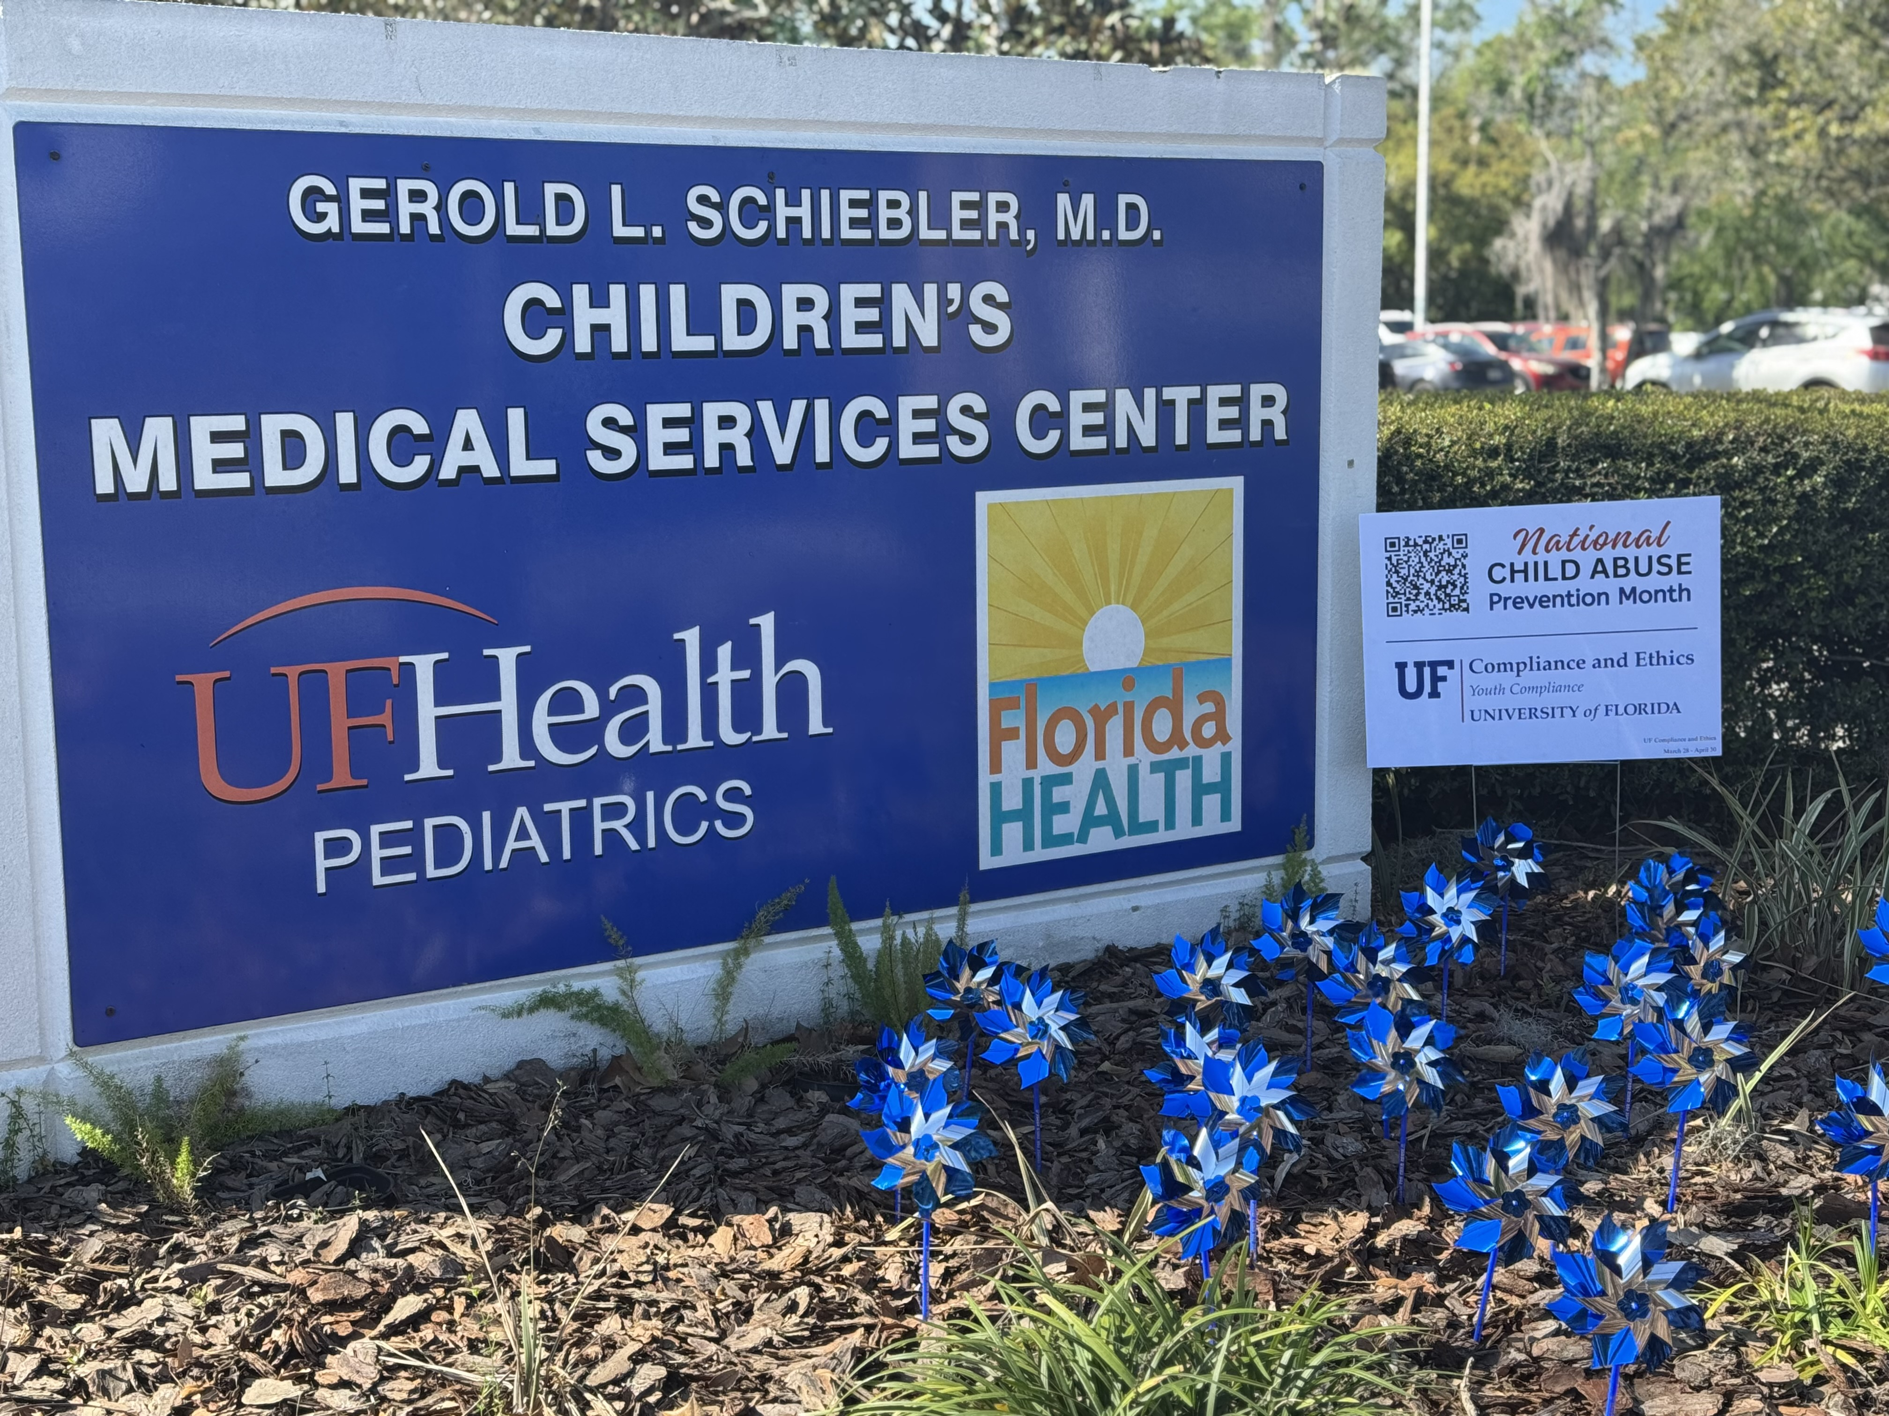
April –National Child Abuse Prevention Month

Slide 35
Training
Mandatory Reporting of Child Abuse Training
YCS100
Topics
Everyone in the state of Florida is a mandatory reporter of child abuse.
General: All citizens of the state
Professional: select professions
Administrators: select high ranking officials within the State University System

Slide 36
Administrators
President
Provost
Senior/Executive Vice Presidents
Vice Presidents
Associate Vice Presidents
Associate/Vice Provosts
Deans
Chief of Police
Equal Opportunity Programs Director
Intercollegiate Athletics Director
Internal Audit Director
Title IX Coordinator
University Compliance Officer
BOG 3.002

Slide 37
Summer Camps
Registration is required for summer camps.
30 days in advance for day camps
60 days in advance for overnight camps
Resources | Youth Compliance | University of Florida
Notes:
UF offers a variety of summer camps on campus and throughout the state.

Slide 38
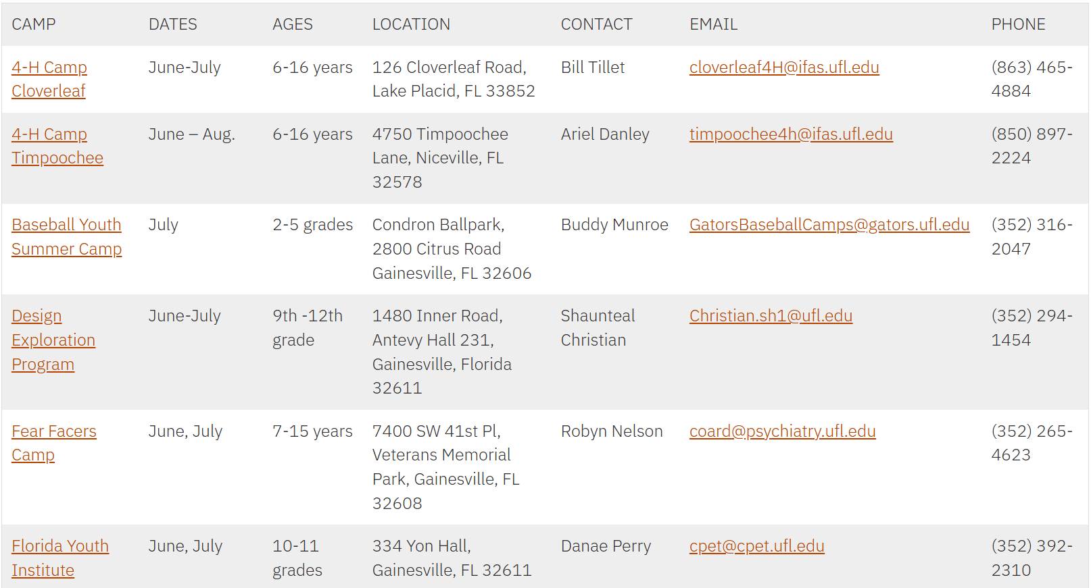
Summer Camp List
UF HR provides a detailed itemized list of university and local summer camps.
Summer Camps 2026 – Worklife

Slide 39
UFCE Learn over Lunch
25-26 UFCE Learn over Lunch Webinar Series
UF Compliance and Ethics is pleased to announce the 2025-2026 UFCE Learn over Lunch series. As always, sessions will be held over Zoom and will start at noon.
UF is committed to providing enriching experiences for youth in both in-person and virtual settings. To uphold that commitment, event planners must understand their responsibilities. Attending this Learn over Lunch is a smart, proactive way to get a solid head start. Reserve your spot today.
When: Thursday, April 9, noon – 12:50
How to sign up: Registration Link (Required for access)
Youth Compliance: Summer Camps and Child Abuse Reporting
Are you planning events for youth under 18 at UF? If so, don’t miss our upcoming UFCE Learn over Lunch webinar (via Zoom)!
Guest Speakers:
Sophia Andrews, Assistant Director, Youth Compliance
Ivelisse Munoz Medina, Assistant Director of Talent Acquisition and Onboarding, Human Resources
Greg Banks, Insurance & Risk Coordinator, Environmental Health & Safety
Key topics include:
Steps to register your event with the Youth Compliance
How to obtain required parental/guardian consent and youth protection trainings
Florida’s Child Abuse Reporting laws and the obligation to report suspected abuse, abandonment, or neglect
Summer Camp Insurance
Necessary background checks
Additional safeguards and best practices

Slide 40
Employee Education Program
Verlissa Ford

Slide 41
Employee Education Program (EEP)
A professional and personal development opportunity that enables fulltime (1.0 FTE) UF staff and faculty, employed at least (6) months, to receive:
Tuition assistance up to (6) eligible credits per semester term.
Florida public university (or college, if TEAMS) closest to their work location.
Must be admitted, or have expectation of admission, to their EEP eligible institution (for semester of attendance) as degree or non-degree seeking student.
Accepting Summer Applications Now!
Application & Director Approval Deadlines
UF EEP Summer A/C Semester – 5PM, April 28
UF EEP *Summer B Semester – 5PM, June 15
*UF Summer B requires separate EEP application, registration period, approval deadlines
Summer 2026 Information Session - April 16, 230 PM via Zoom
Registration Open!
Questions? EEP website or Contact eep@admin.ufl.edu or 352-273-0149

Slide 42
Important Dates
April 23 • Benefits Lunch and Learn: Retirement Planning (12pm-1:30pm) In-person (UFHR Room 120) & Zoom
April 30 • UF Engaged Deadline
May 1 • Application Deadline for UFHR Leadership Development Programs (Managers Cohort, ALAP, Academy)
May 6 • HR Forum

