Slide 1

UFHR Forum
May 6, 2026

Slide 2
Agenda
Termination Files and GA Summer Registration
GBAS PowerUp Wednesdays
PERM Certifications: Application & Posting Process
UFPD Co-Responder Team
Short Work Breaks, Summer Appointments, GA Benefits & Comp Leave Cashouts
Gift Card Reminders
Important Dates

Slide 3
Employment Operations & Records
Johannes Traster

Slide 4
Biannual Termination File
Opening Late May
A termination file will be open from May 22, 2026 – June 12, 2026
File lists active employees who have not received pay in 6 months or more
Effective date in Job Data: June 19, 2026
Why do we do a termination file?
  Help mitigate unnecessary risks
  Have an accurate count of our employment population
  Assist departments in making good decisions for unit/college
  It is NOT an alternative to timely terminations in the system

Slide 5
Termination File Process & Expectations
Action Items
Review the termination file and “uncheck” those individuals who should remain active in the system.
  As EOR reviews the file, we may contact you for additional justification on leaving certain employees active.
  Unchecking all employees without conducting a thorough review is not an acceptable practice and leads to several issues.
The file may contain records of all the salary plans. For example, OPSN, FWS, STAS, OF12, etc. (not an all-inclusive list).

Slide 6
Termination File Cont.
File Navigation
Main Menu > Human Resources > Workforce Administration > Job Information > UF Appointment Review
Enter the Year: 2026
Enter your unit’s Department ID
Enter Termination Date: 06/19/2026

Slide 7
Graduate Assistant Summer Registration
Important Reminder
UF Graduate School’s Registration Requirements state, “Students on an assistantship must be registered appropriately for their appointments”.
It is the department’s responsibility to ensure the GA is appropriately registered to be eligible for appointment during the semester. Run this Enterprise Analytics Report to identify those in your area who are still unregistered.
For questions on registration requirements or other academic expectations, please see the Graduate Catalog; you may also reach out to the UF Graduate School at https://grad.ufl.edu/contact-us/.
Upcoming Dates & Deadlines:
Classes begin May 11th
Drop/Add is May 11–12th
2026-2027 Dates & Deadlines: https://catalog.ufl.edu/UGRD/dates-deadlines/2026-2027/

Slide 8
Training & Organizational
Development
Gwynn Cadwallader

Slide 9



GBAS PowerUp! Wednesdays
From 1-2pm in Zoom.
Register in myTraining UF_GBS800
Focused on Workday!
Registration Required. Closes the Friday before the session.
Questions Answered & Collected.
Recordings are Posted.
Resources posted on Empowering UF Education page.

Slide 10
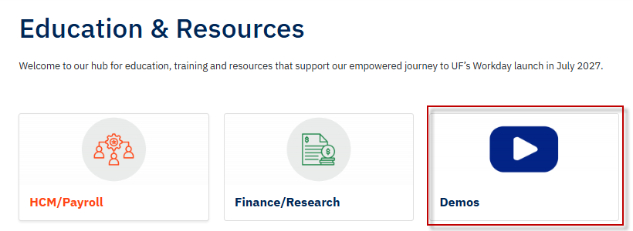
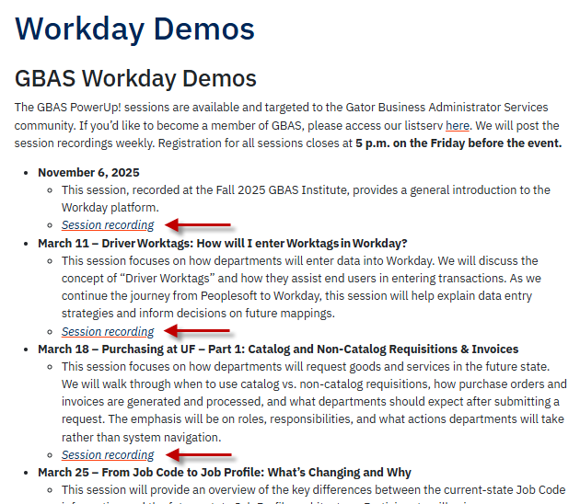
Upcoming HCM Sessions
May 6, 2026
End-to-End Time Tracking: Time Entry to Manager Approval
June 3, 2026
New Hire Benefits Enrollment & Change Benefits Process
June 10, 2026
Navigating Time Off in Workday: Request to Approval
June 17, 2026
Part 1: Hiring New Workers & Onboarding Setup
June 24, 2026
Part 2: Onboarding for a New Hire

Slide 11
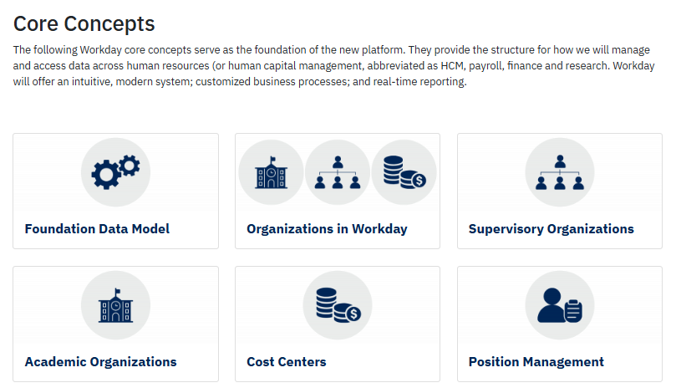
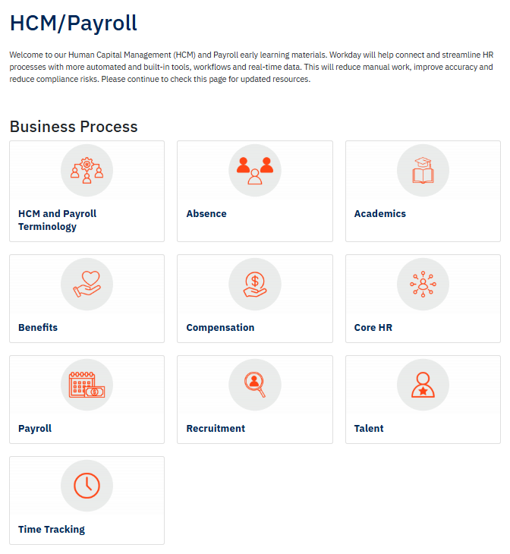
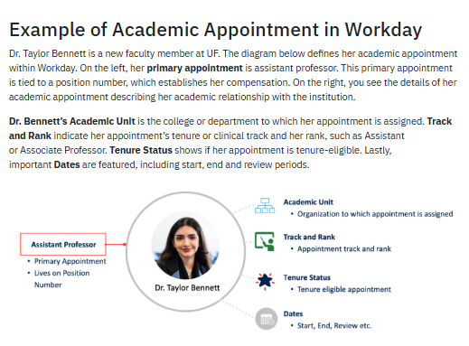

Slide 12
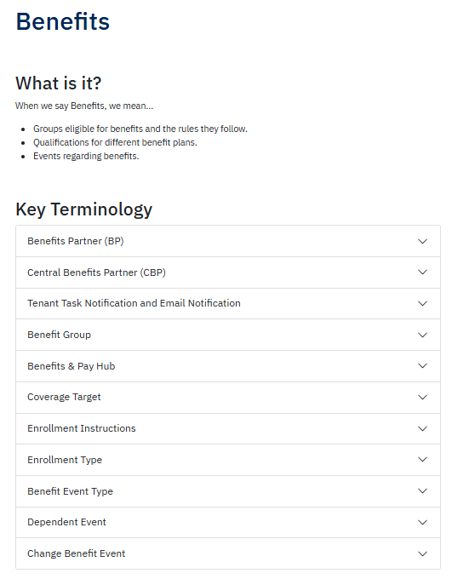
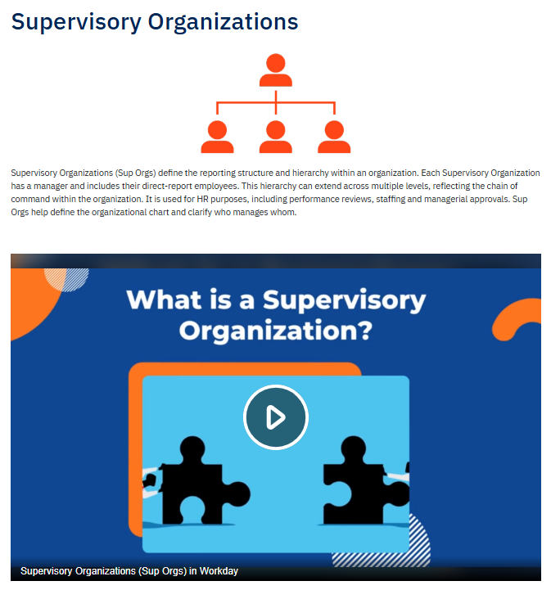

Slide 13
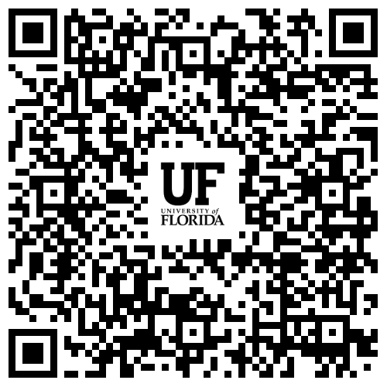
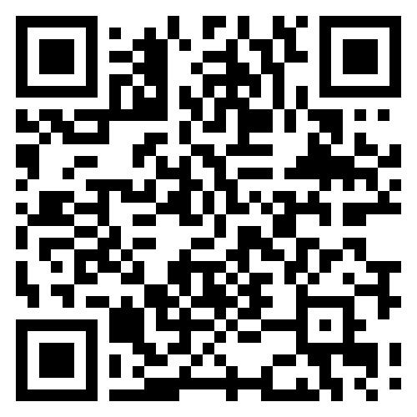
Thank You
For more information, please visit the following resources on our Empowering UF website: https://empowering.ufl.edu/education/
Workday Demos
Education & Resources
Home Page

Slide 14
Immigration Compliance Services
Audrey Gainey

Slide 15

PERM Labor Certification - Application and posting process
Opportunities:
Increase the integrity of our PERM (Program Electronic Review Management) process
  Compliance,
  Consistency, and
  Audit Readiness
Provide a uniform workflow for reviewing, tracking, and dispositioning applicants the same way.
Improve reporting that quickly document applicant flow and recruitment outcomes.
Align with future state in Workday.

Slide 16
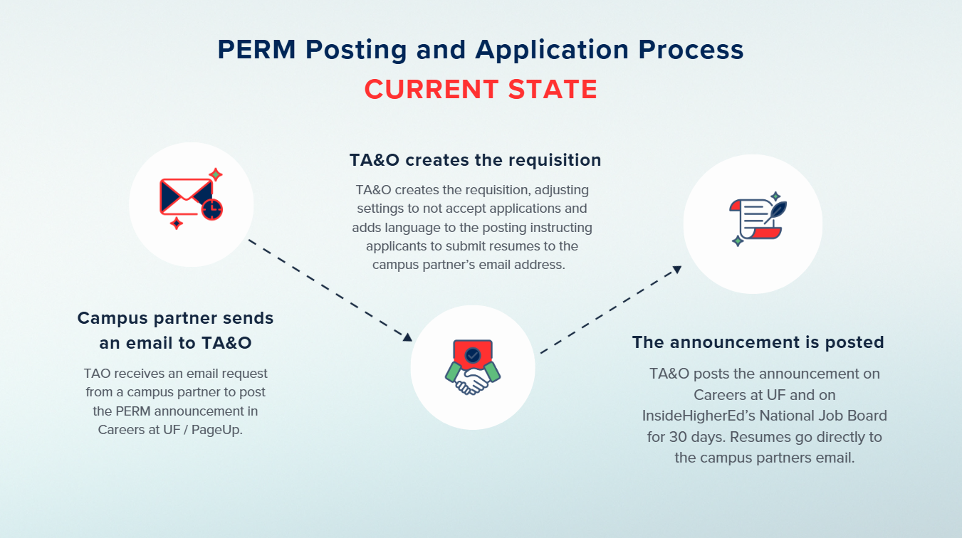

Slide 17
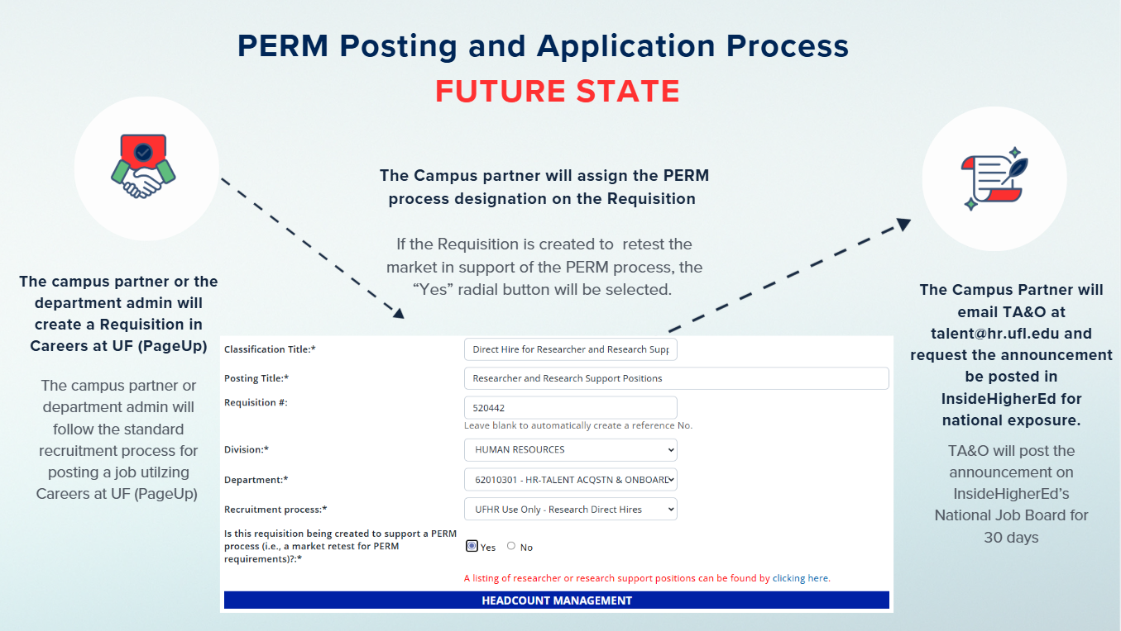

Slide 18
When should I start using Careers at UF to manage the PERM posting and application materials
Effective 5/7/2026!
Contact Immigration Compliance Services at ICS@hr.ufl.edu, or
Talent Acquisition and Onboarding at talent@hr.ufl.edu
For support with creating PERM requisitions, visit the UF HR website https://admin.hr.ufl.edu/hiring/employment-visa-sponsorship/employment-based-permanent-residency/

Slide 19
UF Police Department
Meggen Tucker Sixbey

Slide 20
UFPD
Co-Responder Highlighted
UFPD Co-Responder Team
National
Inside Higher Education
Insight into Diversity
Police
Journal for International Association of Campus Law Enforcement Administrators
The Chronicle
Local
Independent Florida alligator
UF News
UF Business Affairs
Gainesville Sun
About Campus
Policing: An International Journal

Slide 21
What Is a
“Co-Responder Team”?
Specialty Team:
Crisis Intervention Team Trained (CIT) Officer
+
Mental Health Crisis Worker
Respond to calls together where the assistance of a trained mental health clinician could be helpful for a person experiencing distress or having a behavioral health crisis

Slide 22
What Are Goals of a Co-Responder Team?
Increased safety for all
Increased connections to appropriate behavioral health services
Reduced mental health hospitalizations
Reduced use of force
Reduced arrests

Slide 23

Who Do They Assist?
Anyone within UFPD’s jurisdiction!

Slide 24
When are UFPD’s Co-Responder
Teams Operating?
Monday – Thursday 8:00 A.M. – 12:00 A.M.
Officers work 24/7.
There is a high probability at least 1 team officer will be working when you call!

Slide 25
What to Expect
A uniformed police officer with a clinician (possibly other officers too)
Will likely ask you what is going on (even if you just told dispatch)
May ask you for space so they can speak privately with the person in crisis
May not communicate fully what was said to respect the person’s privacy. Will communicate important details
The goal is to connect the person with the most appropriate resources. That may include referrals or driving the person somewhere.

Slide 26
How Can We Access The Co-Responder Team?
By calling UFPD Dispatch at:
(352) 392-1111

Slide 27
Who Can I Contact For Questions?
Meggen Tucker Sixbey, PhD, LMHC, LMFT
Director, Behavioral Services Division
University of Florida Police Department
Sixbey@ufl.edu
(352) 273-3337

Slide 28
Benefits
Nadja Schimmel-Cruz

Slide 29
Short-Work Break for 9M & 10M
A Short-Work Break (SWB) allows eligible State Health employees (9/10-month) to maintain coverage while they are off contract and returning in the fall.
No additional deductions are taken during the summer, even if there are changes to their compensation.
State of Florida health plans and select UF benefits will continue through the summer, with payroll deductions resuming in September.
Please advise faculty to contact our office if they receive any correspondence from People First regarding deduction issues so we can review and assist
Faculty who complete the Spring semester and were double-deducted will have State coverage through the end of September.

Slide 30
Summer New Hire Reminders
Hiring prior to Fall 2026 start​ best practices:
Avoid hiring 9M faculty in the summer for benefits to start before the start of the Fall semester due to file issues to the State.​
Only applies to those hired on FASU appointments. ​
If you must hire someone who would like benefits to start during the summer, it must be coordinated with our office to ensure proper enrollment and summer coverage prior to submitting the ePAF.​
Please inform the Benefits Administration Team immediately of any new summer faculty hires by emailing benefits@ufl.edu.

Slide 31
9M Summer GA Appointments
When possible, avoid terminating 9M appointments if the GA is returning in the Fall but place on a Short-Work Break. ​
​Terminating a 9M appointment will cause coverage to term at the end of May even if double deductions occurred
A GA is only able to keep their GatorGradCare if they are placed on Short Work Break or immediately hired on a Summer appointment (no lapse in appointments). ​
GAs who are terminated and rehired with a break in service will have a new event to enroll in benefits. ​
Contact Heidi Evans with our Customer Service team with any questions or unique situation at gabenefits@hr.ufl.edu

Slide 32
Fiscal Year Comp Leave Cashout
Begin looking at Overtime and Special Compensatory leave balances
Accrued comp leave can be taken in place of other leave types, except Paid Family Leave (PFL)
Review accruals anytime
  Enterprise Reporting > Access Reporting > Human Resources Information > Benefit Information > Leave > Leave Accruals, Usage, and Balances By Pay Period, Department - COMP ONLY
Employees can enter comp time through 06/04/2026
Comp cash-out expected June 26, 2026, paycheck
Use December Personal Leave Days before Fiscal Year end

Slide 33
CFO Office
Nikki Kelton &
Michelle Castaline

Slide 34
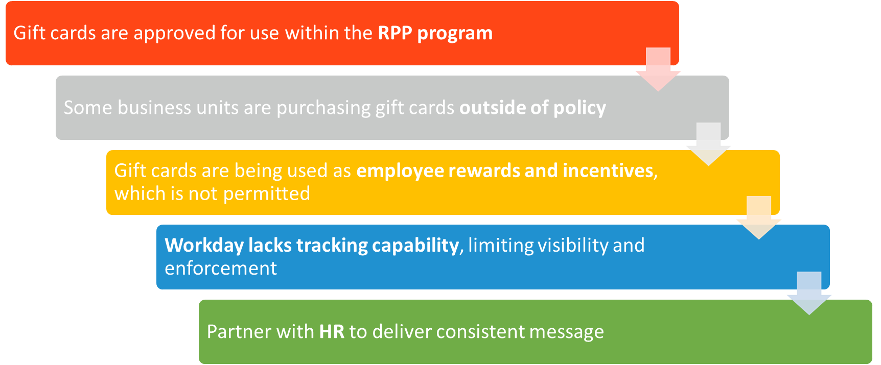
Gift Card Reminders

Slide 35
Important Dates
May 8 • Graduate Assistant New Hires Orientation (every other Friday through October 9, 2026) via Zoom
May 25 • Memorial Day Holiday
June 3 • HR Forum

