Slide 1

UFHR Forum
September 2, 2026

Slide 2
Agenda
University Benefits
Accelerated Payroll, Florida Minimum Wage, and Pay Program Announcement
Research & Research Support Screening
Superior Accomplishment Awards
Important Dates

Slide 3
Benefits
Shannon Edwards

Slide 4
Open Enrollment 2027
Open Enrollment: Monday, October 12 at 8:00 a.m. EST through Friday, October 30 at 6:00 p.m. EST
Benefits & Wellness Fair: Tuesday, October 13, 10:00 a.m.–2:00 p.m.
  Preregistration will be available. More details coming soon.
Passive Enrollment: Open Enrollment will be passive, meaning current elections will continue if no changes are made
Open Enrollment Training: Invitations will be sent to all HR Liaisons to learn about OE 2027. An OE training presentation will be provided so departments can lead OE sessions, or UFHR Benefits can lead onsite presentations.

Slide 5
Employment Operations & Records
Classification & Compensation
Johannes Traster

Slide 6
Accelerated Payroll Deadline
UF will be closed on Friday, October 9th in observance of Homecoming!
The payroll schedule for this accelerated payroll is as follows:
    Thursday, October 1st: HR deadline for ePAF transactions
    Wednesday, October 7th: Time & Labor closes
    Thursday, October 8th: Payroll Running
  Please see UF’s Payroll Schedules for more details.

Slide 7
Reminder: Florida Minimum Wage
Florida voters approved an amendment in November 2020 that increases the minimum wage each year until it reaches $15 per hour in 2026.
Effective September 30, 2026, our state minimum wage will increase from $14 to $15 per hour.
Wage increases for employees below this mark will be administered by a file, so no manual job edit ePAFs are necessary.

Slide 8
Pay Program Announcement
Recently, President Bell announced a salary increase program that will provide a merit raise pool salary for out-of-unit faculty and staff effective October 1, 2026.
UF and the United Faculty of Florida (UFF) have reached a tentative agreement on salary increases for in-unit faculty, with the exception of P.K. Yonge faculty.

Slide 9
Pay Program – Criteria
﻿﻿Eligibility Criteria
﻿﻿Employees must be hired on or before June 30, 2026
﻿﻿Employees who have received a notification of non-renewal are not
eligible for a salary increase
OPS employees are not considered eligible for the salary increase program
﻿﻿Employees must be active at the time salary increases are awarded
﻿﻿Staff who have received discipline in the form of a written reprimand or who have been suspended since January 1, 2026, are also not eligible for a salary increase.
﻿﻿ Employees on a performance improvement plan are not eligible for a salary increase.

Slide 10
Pay Program – Guidance
Recommendations for Managers and Departments
As in prior years, to provide managers with the flexibility to allocate rewards based on individual contributions or market factors, UFHR’s communication and instruction guides will state that funds are being made available to offer salary increases rather than sharing the size of the salary increase pool as a percentage of employee salaries.
As a manager, providing fair and competitive compensation is vital to attracting, retaining, and rewarding your employees.
While there are a variety of approaches, including monetary and non-monetary rewards, it’s essential that salary increases recognize each employee’s contribution to the university.
As leaders, it’s critical that we maximize the impact of funds made available for salary increases by differentiating rewards based on individual contributions, performance, and market factors.

Slide 11



Pay Program – Performance Measures
Allocating Rewards
It’s helpful to view a combination of outcomes and behaviors which can be assessed using four quadrants:
High Outcomes - Low Behaviors
High Outcomes - High Behaviors
Low Outcomes - High Behaviors
Low Outcomes - Low Behaviors
EMPLOYEE PERFORMANCE CONTINUUM
HIGH OUTCOMES & LOW BEHAVIORS Merit Increase: Average | HIGH OUTCOMES & HIGH BEHAVIORS Merit Increase: Top
LOW OUTCOMES & LOW BEHAVIORS | LOW OUTCOMES & HIGH BEHAVIORS
Merit Increase: None | Merit Increase: Emerging
O U T CO M ES
OB SE R VA B L E B E H AVI OR S

Slide 12
Pay Program – Important Dates
Implementation Timeline
  Tuesday, September 8 – Friday, September 18
  Raise review file available to managers and college departmental administrators to enter faculty and staff raises
  Monday, September 21 – Wednesday, September 23
  Raise review file available to only college department administrators
  Monday, September 28
  Increases are viewable in myUFL
  Friday, October 16
  First paycheck with salary increases

Slide 13
Pay Program –
Timing Considerations
UFHR Salary Increase Process
  Salary increases may not be retroactive.
  Upcoming ePAFs modifying an employee’s Job Data with a future effective date of October 1, 2026, or beyond, can cause an error to occur when the raise file is executed.
  As a result, departments should minimize job and position actions that impact an employee’s Job Data until raises are loaded.

Slide 14
Pay Program – Resources
Additional materials and supporting documents will be published on the UFHR Classiﬁcation & Compensation website.
    Raise File Instruction guide – will provide additional guidance on how to access and enter raises in myUFL
    Manager Guide - provides recommendations on determining individual merit increases
    Feel free to contact Classiﬁcation & Compensation with questions via email at salaryincrease@ufl.edu.

Slide 15
Talent Acquisition and Onboarding
Audrey Gainey

Slide 16
Researcher Screening
FS 1010.35 Requires that UF screen all research and research support positions prior to hire or access to research data or materials.
Researcher/Research Support is defined as a person who:
  Directs or conducts research or
  Receives training in the conduct of research or
  A person who collects, manipulates or controls access to research data
Starting Monday, September 14th, hiring units must conduct screening to ensure that all GA hires are in compliance with Florida Statute 1010.35.

Slide 17
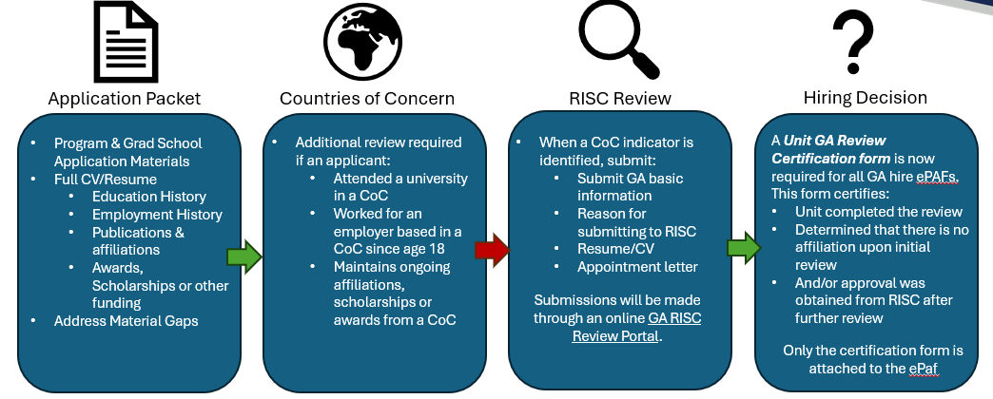

GA Researcher Screening

Slide 18
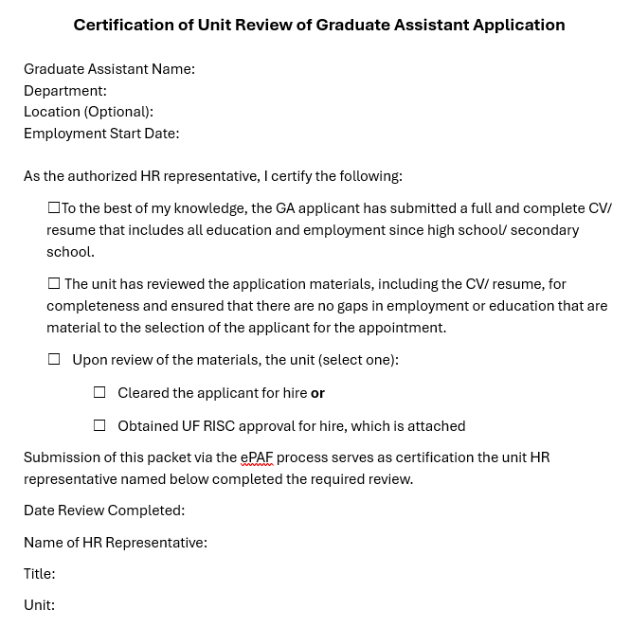
Certification Form

Slide 19
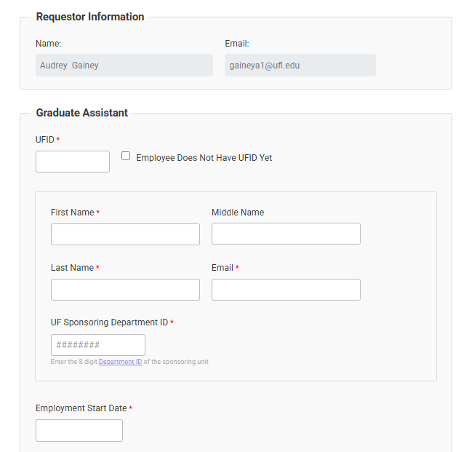
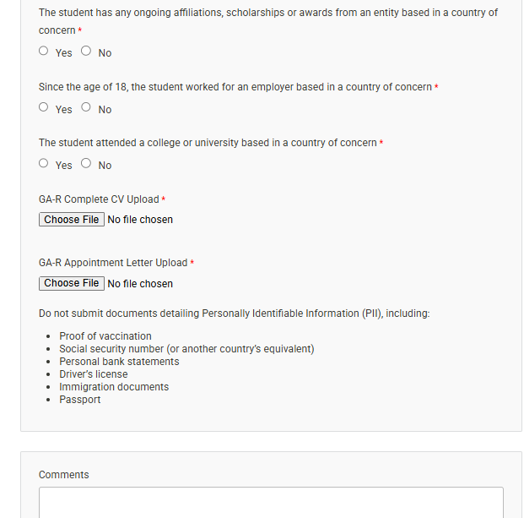

UF RISC Screening Form
(Submitted through the portal only if CoC is an issue)

Slide 20
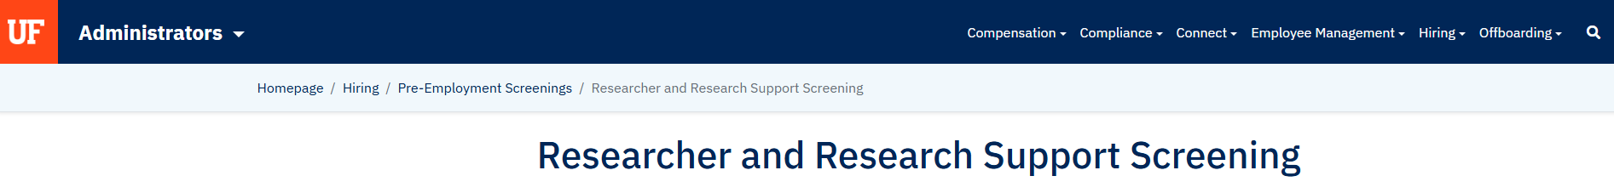
FAQS:
What is included in the application packet?
What is considered a material employment gap?
How long should the gap be before review?
How long is an approval valid?
Do summer (short work) breaks or appointment type changes require a new review?
Does a work location change require another review?
Website:
https://admin.hr.ufl.edu/hiring/pre-employment-screenings/researcher-and-research-support-screening/

Slide 21
Who to contact:
For ePAF questions Contact Employment Operations and Records (EOR)
ufhr-employment@ufl.edu
352-273-1079 for EOR
For Research questions Contact Research Integrity, Security & Compliance (RISC)
https://research.ufl.edu/compliance.html
international@research.ufl.edu
352-273-9174

Slide 22
Superior
Accomplishment
Awards
Mimi Grabavoy

Slide 23

Superior Accomplishment Awards
This program recognizes eligible faculty and staff members across the University of Florida and the UF Health enterprise.
Nominations close on October 23rd at 11:59 p.m.
Nominations and Awards Types
Individual Employee Performance
Rookie of the Year
Team Collaboration
Sustained Excellence
Notes:
The program honors those who have demonstrated outstanding and meritorious service, improved efficiency, operational excellence and/or made a meaningful impact on the quality of life for students, patients, employees and the communities we serve.
We have several award categories, including Individual Employee Performance, Rookie of the Year, Team Collaboration, and Sustained Excellence.
Employee Performance
For IEP. Nominations in this category reflect individual contributions and are separated by Job Family.
Office Administration, Human Resources and Information Technology
Operations and Safety
Health Care and Physical Sciences
Finance, Research and Compliance
Student, Academic and Alumni Services
Faculty
Rookie of the Year: Nominees for the Rookie of the Year are newcomers who, having successfully passed their probationary period, have excelled and had a positive impact through their work early on in their role at UF. For this award, a newcomer is defined as someone who has been at UF for less than two years.
Team Collaboration: Nominations in this category are for a team of employees (maximum of six) who worked together to accomplish great things for the institution and its future. For this award, the employee listed as Nominee is considered the Team Lead and others are Team Members.
Sustained Excellence: Designed to recognize an employee for a project or initiative that has demonstrated exceptional impact, success, and sustained excellence over a period of at least five years. Nominees must not have received this award within the same five-year period.
If you know someone who deserves this recognition, please note that nominations close on October 23RD. I encourage you to submit your nominations and help us celebrate the outstanding contributions of our faculty and staff members.

Slide 24
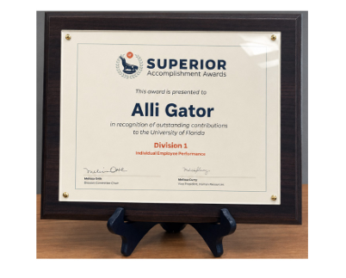
Awards
Division-level Award recipients receive $300, an exclusive gift and a framed certificate.
Notes:
Division-level awards recognizes individuals from different schools, colleges, divisions, units or departments. Individuals from their own respective divisions will be evaluated against other divisions. Selected recipients from each division will then compete for university-level awards.
Division-level winners receive $300 along with a certificate of appreciation and a university memento.
Each division winner becomes eligible for a trophy as well as 1 of 9 university-level $2,000 awards or 1 of 6 Special Recognition Awards of $1000.
Each award is subject to applicable taxes.
<next slide please>

Slide 25
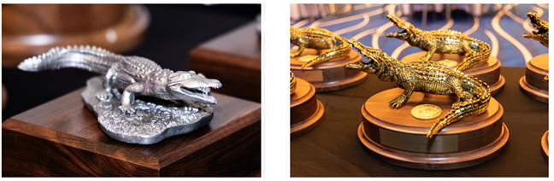
University-level Awards
Awards
All division winners compete for university-level Gold and Special Recognition awards, nine receiving $2,000 and a gold trophy and six receiving $1,000 and a silver trophy.
All awards are subject to applicable taxes.
Notes:
Division-level awards recognizes individuals from different schools, colleges, divisions, units or departments. Individuals from their own respective divisions will be evaluated against other divisions. Selected recipients from each division will then compete for university-level awards.
Division-level winners receive $300 along with a certificate of appreciation and a university memento.
Each division winner becomes eligible for a trophy as well as 1 of 9 university-level $2,000 awards or 1 of 6 Special Recognition Awards of $1000.
Each award is subject to applicable taxes.
<next slide please>

Slide 26
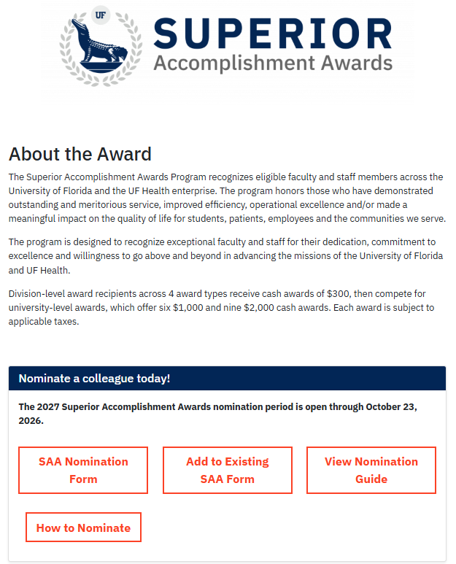
Website Updates

Slide 27
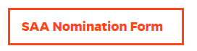
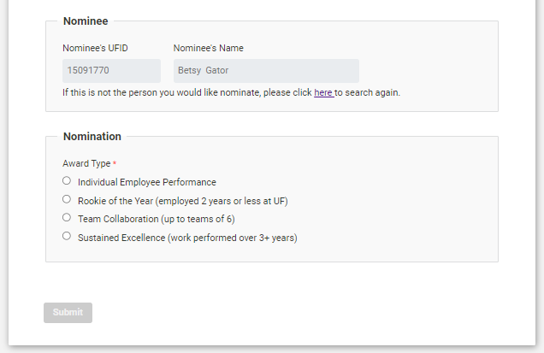
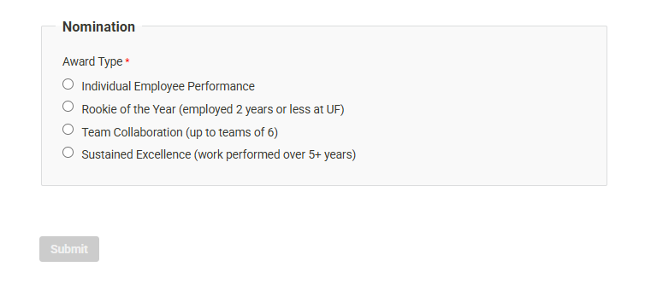
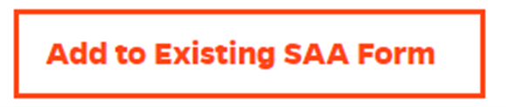
Nominations
  Augmentation Form
  Eliminates duplicated nominations
  Dedicated to those who need to add attachments to the nomination already submitted

Slide 28


How to Nominate?
Determine the nominee
Gather Elements
Submit the Nomination
Notes:
By nominating, you help:
Recognize Excellence
Boost Employee Morale
Inspire Others
Support Employee
Engagement Strengthen Our UF Community

Slide 29
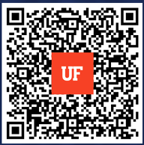
Nominate a Colleague Today!
To learn more about the Superior Accomplishment Awards, scan the QR code or email us at SAA@hr.ufl.edu
Notes:
If you have any questions or need help with the nomination process, please don't hesitate to reach out to us.
Take a moment to think about the colleagues who have made a positive impact, and nominate them today!
Thank you.

Slide 30
Important Dates
September 7 • Labor Day Holiday
October 1 • Open Enrollment Training 8:15 AM
October 12 (8:00 a.m. EST) – October 30 (6:00 p.m. EST) • Benefits Open Enrollment
October 13 • Benefits and Wellness Fair from 10:00 a.m. – 2:00 p.m. at the Evans Champions Club (Ben Hill Griffin Stadium)
October 23 • SAA Nominations Close 11:59 p.m. EST

